Slide 1
SDE/Cloud Integration Services
Extreme Blue Project
Interns:Alka Yadav, Ronak Lokhwani
Concept: Anbazhagan Mani
Technical Mentors:Ashish Billore, Sudipta Biswas
Management:Mahesh Sundram, Muni Reddy
Notes:
1

Slide 2
Cloud Integration Services: Facilitating wider adoption of IBM Cloud/SDE offerings such as IceCastle
Business Partner
Systems Integrator
Extensible Cloud Integration Services
Architected mechanism to develop and deliver services and solutions on top of IBM's Cloud/SDE Foundation layer
Partner with SWG, ISVs, Business Partners and third party software providers to provide services and solutions
Joint GTM by fostering collaboration with BPs and ISVs.
Flexible delivery models over the cloud and on premise
Solution
Provider
ISV
Services (SaaS, PaaS)
Solutions
New
Extensible Cloud Integration Services
IBM Cloud (IaaS/SDE Foundation)
IBM hosted or Customer infrastructure
Proposed Approach: Leverage IceCastle and Operations Manager extensibility model to deliver Cloud Integration Services
2
Notes:
2
Virtual Admin: setting up pools, policies
Cloud Admin (Smart Cloud Admin … concerned about developing the catalog entries for self service, billing function)
Chief Marketing Office (CMO): uses analytics to understand buyer behavior
Satisfy the needs of the job executor by minimizing the time it takes to manage and secure the infrastructure
Design the solution to satisfy the job executor, but make sure that every feature can be justified by its contribution to the needs of purchase decision makers.

Slide 3
Extreme Blue Project: CloudFoundry Standup and deploying to OpenStack based on CmwO and PowerKVM*
Cloud
Foundry
Cloud Foundry Integration
Allows integration of PaaS into our IaaS layer provided by IceCastle on both PowerKVM and x86
Demonstrate Extensibility model
Allows new and emerging workloads such as MongoDB, Hadoop to be easily deployed on CMwO Cloud and PowerKVM* platform
2. Stands up CF
CIS Extension
3.. Configure Cloud on CF
4. Deploy Workload to Cloud
IceCastle Ops Manager
OpenStack
Cloud
Stands up OpenStack Cloud
CIS – Custom Integration Service
CF – Cloud Foundry
IBM Cloud (IaaS/SDE Foundation)
*Phase 2 Milestone
Notes:
3
Virtual Admin: setting up pools, policies
Cloud Admin (Smart Cloud Admin … concerned about developing the catalog entries for self service, billing function)
Chief Marketing Office (CMO): uses analytics to understand buyer behavior
Satisfy the needs of the job executor by minimizing the time it takes to manage and secure the infrastructure
Design the solution to satisfy the job executor, but make sure that every feature can be justified by its contribution to the needs of purchase decision makers.

Slide 4
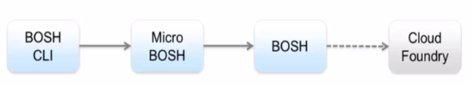
Cloud Foundry Deployment process
Setup BOSH CLI
Deploy Micro BOSH
Deploy BOSH
(BOSH - Tool we use to deploy the components of Cloud Foundry onto distributed nodes)

Slide 5
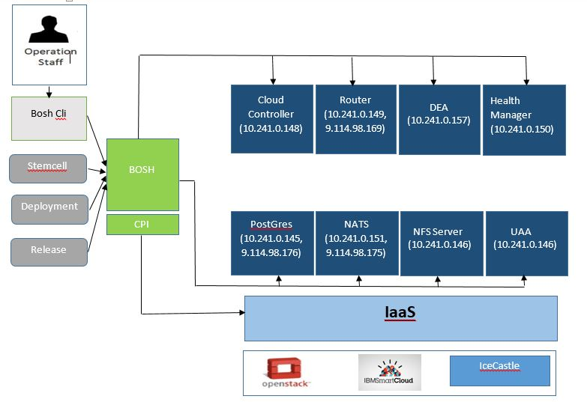
Cloud Foundry Admin perspective

Slide 6
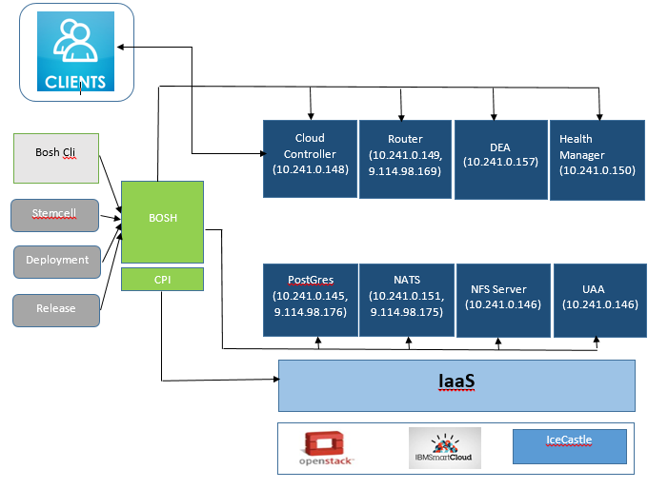
Client perspective

Slide 7
Milestones & Progress
1. Learning:
Basics of Cloud Computing services : Iaas, Paas & SaaS
Openstack Architecture
Learnt python Language to have an understanding of the Openstack's source code.
Types Of Networking available in Openstack and Concept of Floating IPs.
Cloud Foundry Networking and wiring of VMs.
How Cloud Foundry jobs could be created in a limited resources environment.
What all changes will be required in case Cloud Foundry is set up under the IaaS which has hardware as x86 and PowerKVM nodes.
2. Cloud Foundry set up - Progress 100% complete
Cloud Foundry set up consists of setting up and configuring components across 8 VMs
Successfully provisioned all 8 VMs on Ice Castle .
Chef integration
3. Provision platform / service through Cloud Foundry on IceCastle Cloud – Progress: 90% Complete
Create a test service to be provisioned through CF
Import this test service to CF's repository of available services
Deploy this test service through CF on IceCastle Cloud
4. Add PowerKVM Node as deployment target on CF and provision applications – Phase 2
Configure PowerKVM Controller in the given Cloud Foundry environment
5. PowerKVM Node managed through Ice Castle – Progress: 100% Complete
PoC completed to ensure Ice Castle can manage PowerKVM nodes alongside x86 Node
7
Notes:
7
Virtual Admin: setting up pools, policies
Cloud Admin (Smart Cloud Admin … concerned about developing the catalog entries for self service, billing function)
Chief Marketing Office (CMO): uses analytics to understand buyer behavior
Satisfy the needs of the job executor by minimizing the time it takes to manage and secure the infrastructure
Design the solution to satisfy the job executor, but make sure that every feature can be justified by its contribution to the needs of purchase decision makers.

Slide 8
Challenges
Lack of enough documentation on using Cloud Foundry in conjunction with OpenStack IceHouse
2. Lack of dedicated PowerKVM Environment
3. All technologies were too new to interns
8
Notes:
8
Virtual Admin: setting up pools, policies
Cloud Admin (Smart Cloud Admin … concerned about developing the catalog entries for self service, billing function)
Chief Marketing Office (CMO): uses analytics to understand buyer behavior
Satisfy the needs of the job executor by minimizing the time it takes to manage and secure the infrastructure
Design the solution to satisfy the job executor, but make sure that every feature can be justified by its contribution to the needs of purchase decision makers.

Slide 9
Thank You!!
9
Notes:
9
Virtual Admin: setting up pools, policies
Cloud Admin (Smart Cloud Admin … concerned about developing the catalog entries for self service, billing function)
Chief Marketing Office (CMO): uses analytics to understand buyer behavior
Satisfy the needs of the job executor by minimizing the time it takes to manage and secure the infrastructure
Design the solution to satisfy the job executor, but make sure that every feature can be justified by its contribution to the needs of purchase decision makers.

